Slide 1
Object-Detection 物件偵測
崑山科技大學資訊工程所
深度學習Deep Learning課程
報告人：程鈺凱
指導恩師：曾龍
繳交日期:2020.06.11

Slide 2
Agenda
安裝-import和定義函數
Import
定義函數
安裝-import函數和功能定義

Slide 3
import

Slide 4
import
# For downloading the image. import matplotlib.pyplot as plt import tempfile from six.moves.urllib.request import urlopen from six import BytesIO

Slide 5
import
# For drawing onto the image. import numpy as np from PIL import Image from PIL import ImageColor from PIL import ImageDraw from PIL import ImageFont from PIL import ImageOps

Slide 6

定義函數

Slide 7
import
# For measuring the inference time. import time # Print Tensorflow version print(tf.__version__) # Check available GPU devices. print("The following GPU devices are available: %s" % tf.test.gpu_device_name())
安裝-import函數和功能定義

Slide 8
display_image
def display_image(image): fig = plt.figure(figsize=(20, 15)) plt.grid(False) plt.imshow(image)

Slide 9
download_and_resize_image
def download_and_resize_image(url, new_width=256, new_height=256, display=False): _, filename = tempfile.mkstemp(suffix=".jpg") response = urlopen(url) image_data = response.read() image_data = BytesIO(image_data) pil_image = Image.open(image_data) pil_image = ImageOps.fit(pil_image, (new_width, new_height), Image.ANTIALIAS) pil_image_rgb = pil_image.convert("RGB") pil_image_rgb.save(filename, format="JPEG", quality=90) print("Image downloaded to %s." % filename) if display: display_image(pil_image) return filename

Slide 10
draw_bounding_box - 1
def draw_bounding_box_on_image(image, ymin, xmin, ymax, xmax, color, font, thickness=4, display_str_list=()): """Adds a bounding box to an image.""" draw = ImageDraw.Draw(image) im_width, im_height = image.size (left, right, top, bottom) = (xmin * im_width, xmax * im_width, ymin * im_height, ymax * im_height) draw.line([(left, top), (left, bottom), (right, bottom), (right, top), (left, top)], width=thickness, fill=color)

Slide 11
draw_bounding_box - 2
# If the total height of the display strings added to the top of the bounding # box exceeds the top of the image, stack the strings below the bounding box # instead of above. display_str_heights = [font.getsize(ds)[1] for ds in display_str_list] # Each display_str has a top and bottom margin of 0.05x. total_display_str_height = (1 + 2 * 0.05) * sum(display_str_heights)

Slide 12
draw_bounding_box - 3
if top > total_display_str_height: text_bottom = top else: text_bottom = top + total_display_str_height # Reverse list and print from bottom to top. for display_str in display_str_list[::-1]: text_width, text_height = font.getsize(display_str) margin = np.ceil(0.05 * text_height) draw.rectangle([(left, text_bottom - text_height - 2 * margin), (left + text_width, text_bottom)], fill=color) draw.text((left + margin, text_bottom - text_height - margin), display_str, fill="black", font=font) text_bottom -= text_height - 2 * margin

Slide 13
def draw_boxes - 1
def draw_boxes(image, boxes, class_names, scores, max_boxes=10, min_score=0.1): """Overlay labeled boxes on an image with formatted scores and label names.""" colors = list(ImageColor.colormap.values()) try: font = ImageFont.truetype("/usr/share/fonts/truetype/liberation/LiberationSansNarrow-Regular.ttf", 25) except IOError: print("Font not found, using default font.") font = ImageFont.load_default()

Slide 14
def draw_boxes - 2
for i in range(min(boxes.shape[0], max_boxes)): if scores[i] >= min_score: ymin, xmin, ymax, xmax = tuple(boxes[i]) display_str = "{}: {}%".format(class_names[i].decode("ascii"), int(100 * scores[i])) color = colors[hash(class_names[i]) % len(colors)] image_pil = Image.fromarray(np.uint8(image)).convert("RGB") draw_bounding_box_on_image( image_pil, ymin, xmin, ymax, xmax, color, font, display_str_list=[display_str]) np.copyto(image, np.array(image_pil)) return image

Slide 15
從Open Images v4下載圖片
# By Heiko Gorski, Source: https://commons.wikimedia.org/wiki/File:Naxos_Taverna.jpg #下載圖片 image_url = "https://upload.wikimedia.org/wikipedia/commons/6/60/Naxos_Taverna.jpg" downloaded_image_path = download_and_resize_image(image_url, 1280, 856, True)

Slide 16
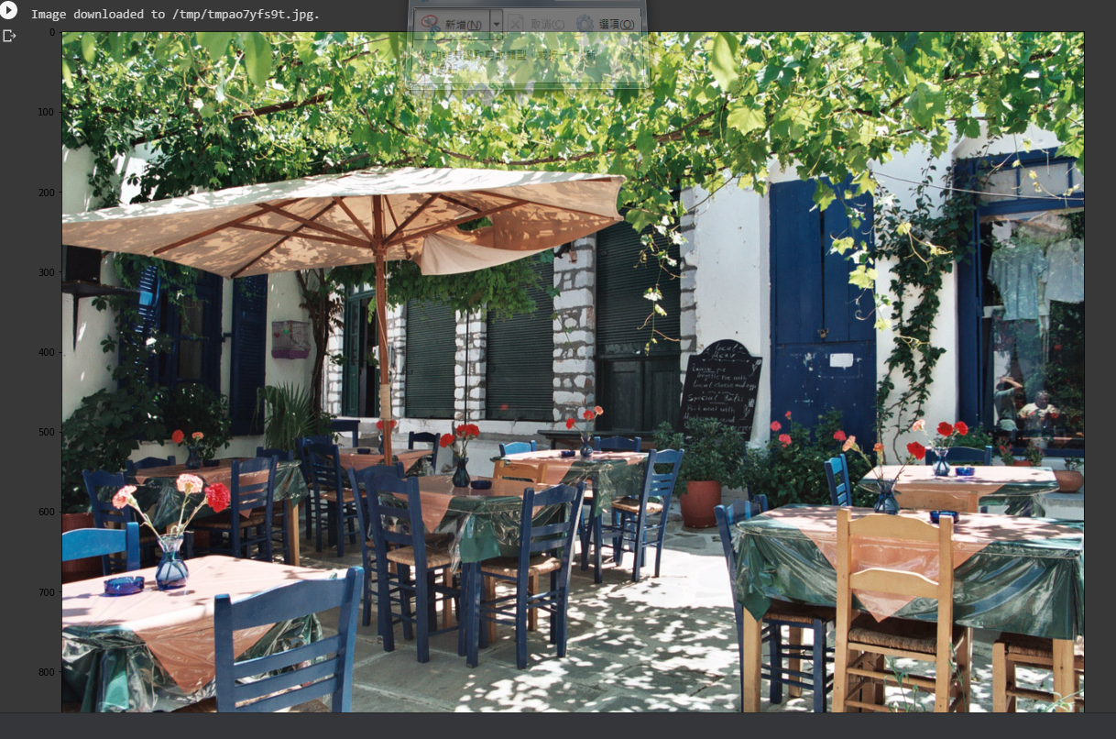
顯示下載的圖片

Slide 17
指定物件偵測的模型和圖片
module_handle = "https://tfhub.dev/google/faster_rcnn/openimages_v4/inception_resnet_v2/1" detector = hub.load(module_handle).signatures['default']
Result: INFO:tensorflow:Saver not created because there are no variables in the graph to restore INFO:tensorflow:Saver not created because there are no variables in the graph to restore

Slide 18
指定圖片
def load_img(path): img = tf.io.read_file(path) img = tf.image.decode_jpeg(img, channels=3) return img

Slide 19
設定物件偵測函數
def run_detector(detector, path): img = load_img(path) converted_img = tf.image.convert_image_dtype(img, tf.float32)[tf.newaxis, ...] start_time = time.time() result = detector(converted_img) end_time = time.time() result = {key:value.numpy() for key,value in result.items()}

Slide 20
設定物件偵測函數
print("Found %d objects." % len(result["detection_scores"])) print("Inference time: ", end_time-start_time) image_with_boxes = draw_boxes( img.numpy(), result["detection_boxes"], result["detection_class_entities"], result["detection_scores"]) display_image(image_with_boxes)

Slide 21
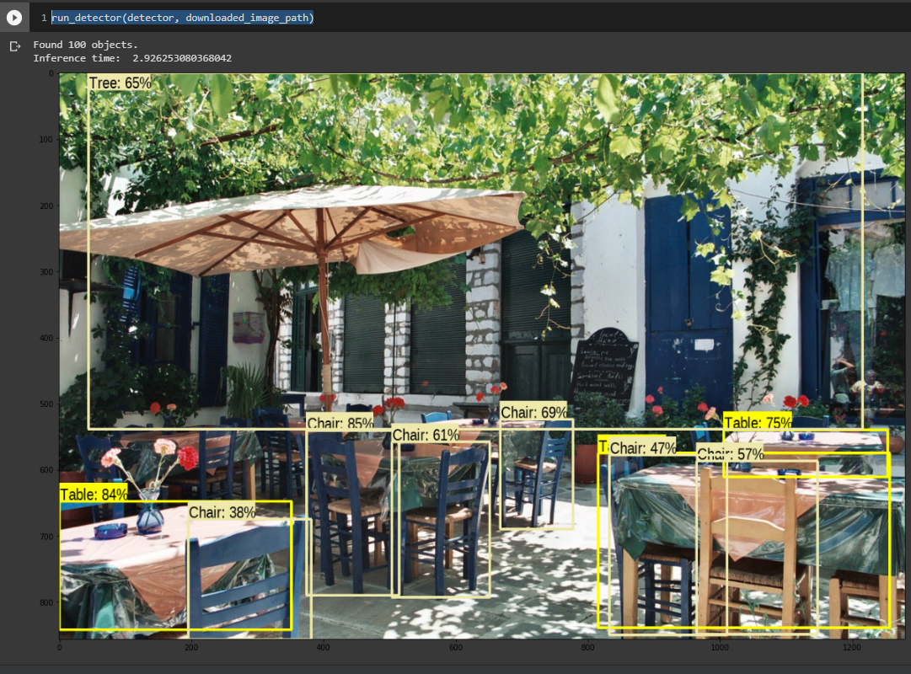
偵測結果
run_detector(detector, downloaded_image_path)

Slide 22
其他圖片-載入圖片
image_urls = [ #第一張圖片 "https://upload.wikimedia.org/wikipedia/commons/1/1b/The_Coleoptera_of_the_British_islands_%28Plate_125%29_%288592917784%29.jpg", #第二張圖片 "https://upload.wikimedia.org/wikipedia/commons/thumb/0/0d/Biblioteca_Maim%C3%B3nides%2C_Campus_Universitario_de_Rabanales_007.jpg/1024px-Biblioteca_Maim%C3%B3nide s%2C_Campus_Universitario_de_Rabanales _007.jpg", #第三張圖片 "https://upload.wikimedia.org/wikipedia/commons/0/09/The_smaller_British_birds_%288053836633%29.jpg", ]

Slide 23
其他圖片-定義物件偵測功能
def detect_img(image_url): # 紀錄時間 start_time = time.time() # 載入圖片、修改大小 image_path = download_and_resize_image(image_url, 640, 480) # 進行物件偵測的函數 run_detector(detector, image_path) # 記錄結束時間 end_time = time.time() print("Inference time:",start_time-end_time)

Slide 24
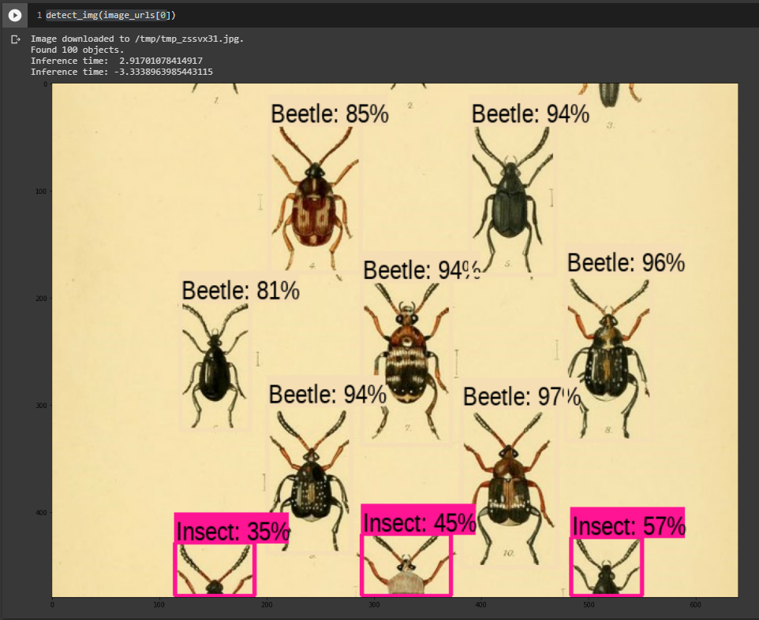
其他圖片-1
detect_img(image_urls[0])

Slide 25
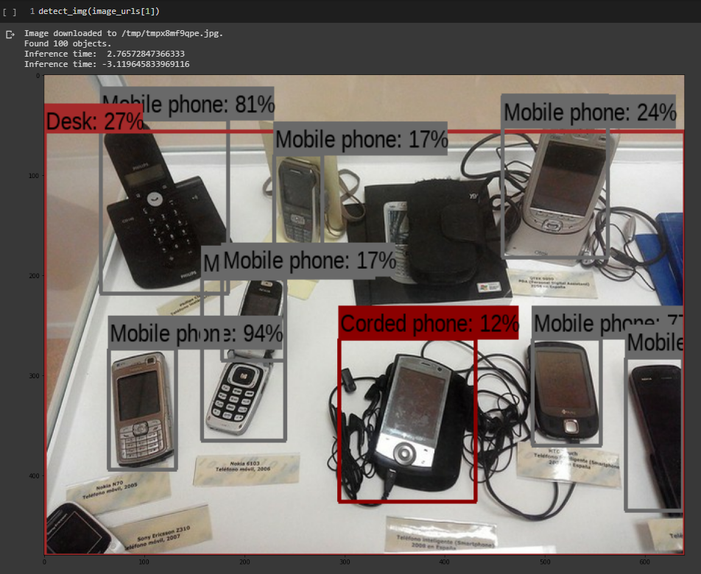
其他圖片-2
detect_img(image_urls[1])

Slide 26
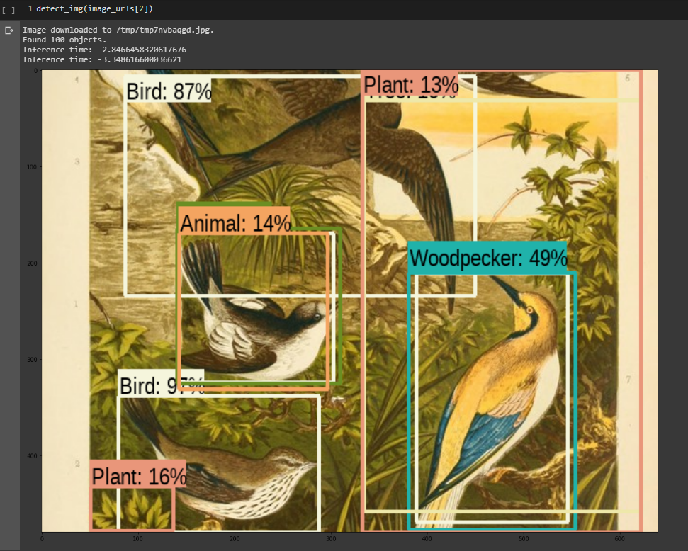
其他圖片-3
detect_img(image_urls[2])

Slide 27
參考文獻
Tensorfloe hub – Object Detection：https://www.tensorflow.org/hub/tutorials/object_detection

Slide 28
Thank you for your Listening

